Slide 1

ONNX：Boosting PaddlePaddle Deployment in Industry
2021.10.21 Jason Jiang
Staff R&D at PaddlePaddle

Slide 2

Outline
1
PaddlePaddle & ONNX
2
Application of Baidu HAVP

Slide 3



Overview of PaddlePaddle
Agile framework for Industrial-level development of deep neural networks
Supports Ultra-Large-Scale training of deep neural networks
High-Performance inference over ubiquitous environments
Industry-leading and fully open sourced models and development kits
飞桨企业版
BML全功能 AI开发平台
EasyDL 零门槛AI开发平台
PaddlePaddle
Tools & Components
AutoDL
PARL
PALM
PaddleFL
PGL
Paddle Quantum
PaddleHelix
PaddleHub
PaddleX
VisualDL
PaddleCloud
End-to-End Development Kits
ERNIE
PaddleClas
PaddleDetection
PaddleSeg
PaddleOCR
PaddleGAN
PLSC
ElasticCTR
Parakeet
AI Studio
Basic Models Bank
PaddleNLP
PaddleCV
PaddleRec
PaddleSpeech
Core Framework
Network Building
Training
Inference
Dynamic Graph
Static
Graph
Large-scale Distributed Training
Paddle
Inference
Paddle
Serving
Security & Encryption
Large-scale IO
PaddleSlim
Paddle Lite
Paddle.js

Slide 4
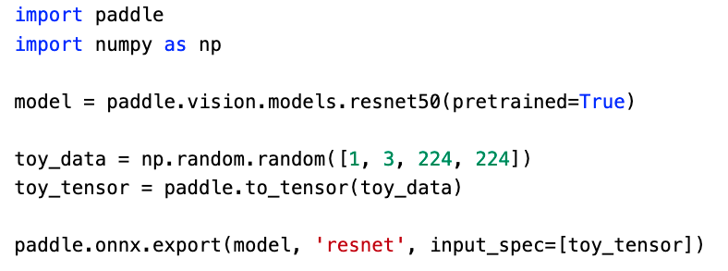
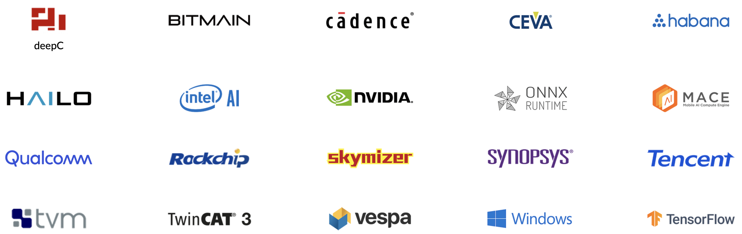
PaddlePaddle & ONNX
Paddle2ONNX supports converting PaddlePaddle to ONNX
Integrate with PaddlePaddle framework
Enrich PaddlePaddle model’s deployment
Export ONNX model by PaddlePaddle 2.0
More Backends

Slide 5
News with Paddle2ONNX
Paddle2ONNX V0.8 released
160+ operators supported
About 100 networks supported, including ppyolov2, ppocr
Custom operators is supported to export
2021 PaddlePaddle Hackathon
50+ operators supported by outside contributors
Cooperation with Chip Manufacturers
Horizon Robotics, Core Rain support PaddlePaddle deployment by Paddle2ONNX
Applications
20+ industry manufacturers deploy PaddlePaddle models in their production system by Paddle2ONNX

Slide 6
Outline
1
PaddlePaddle & ONNX
2
Application of Baidu HAVP

Slide 7







HAVP : Home zone Apollo Valet Parking
The functions of self parking and calling in common scenarios is fully complete by learning the inbound and outbound route only once
Commute–friendly
Shopping–friendly
Easy to go
No worries about the whether
Rookies–friendly
Fetch–and–carry service right on cue
Too heavy to carry? Get in / off right at the door
Family members get off in advance waiting for parking? Unnecessary now
Pouring rain? Not a big deal
Tight parking space is no longer a problem
Advantages of HAVP
Performance
Capability
Creativity
Safety

Slide 8
HAVP : Home zone Apollo Valet Parking
Why Choosing ONNX?
Supported by most common deep learning frameworks, including PaddlePaddle
Easy to deploy on different hardware
More flexible deployment with custom operator
Model Training
Deploy on different hardware
ONNX Converter
TDA4VM Jacinto
Nvidia Jetson Xavier
PaddlePaddle
Other Frameworks
Custom OP
Nvidia Drive Orin
EdgeBoard ZU5EV

Slide 9
HAVP : Home zone Apollo Valet Parking
Baidu HAVP
Competitors
Industry Pioneer
Above–ground and underground parking
Both collection and parking
Route silence update
Auto walkaround to search parking spot
Above–ground parking only
Collection only
40s average time–cost
Typically need more than 2 tries
Low parking spot search success rate
Industry Pioneer
Industry Pioneer
Industry Pioneer
30s average time–cost
Fit into parking spot within 2 tries
More scenarios to be supported
Automatic correction while learning
User route sharing supported
Easy control with mobile app
Industry Pioneer
https://apollo.auto/valet_parking/index_cn.html

Slide 10

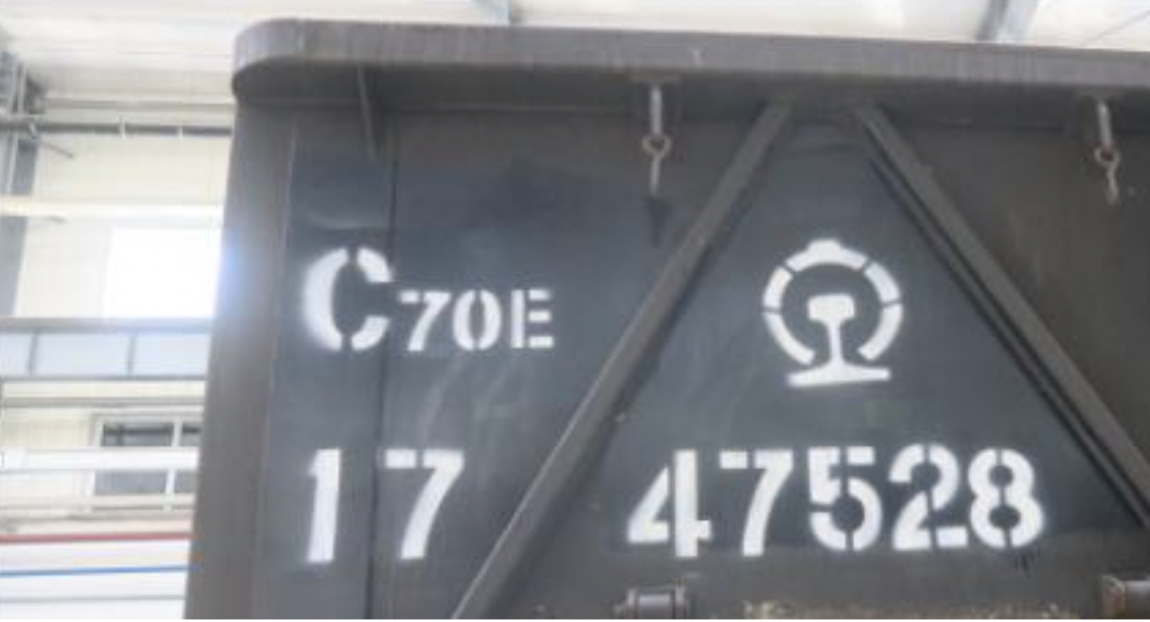
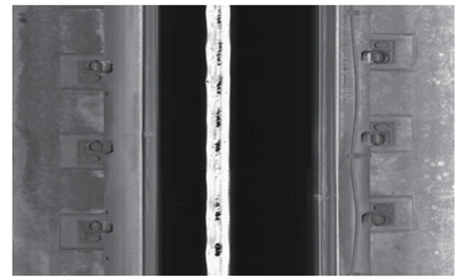
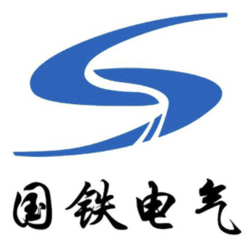
More Applications
WUHANTIELUJU(Wuhan railway bureau)
Safety inspection of railroad tracks
Detection of channels water seepage
Deploy by TensorRT
Link: https://www.sohu.com/a/442530632_104421
Chengdu SinoRail Electronics
Safety inspection of railroad tracks
Detection of channels water seepage
Deploy by TensorRT
Link: https://www.paddlepaddle.org.cn/support/news

Slide 11


For More Information
Explore our open-source projects
https://github.com/PaddlePaddle/Paddle
https://github.com/PaddlePaddle/Paddle2ONNX
Official Website of PaddlePaddle
https://www.paddlepaddle.org.cn
Looking forward for more cooperation!
Contact: paddle-dev@baidu.com

